Slide 1
Chapter 2: Programming Basics

Slide 2
Learning Objectives
Overview of Programming Languages
Definition
Overview of Programming Languages
Elements of Programming Languages
Syntax
Semantics
Type System
Standard Language Library
Advanced Topics
Implementation
JIT (Just-In-Time) and Runtime/VM
Multi-Target development platforms

Slide 3
Programming Language: Definition
“A programming language is a notation for writing programs, which are specifications of a computation or algorithm. Some, but not all, authors restrict the term "programming language" to those languages that can express all possible algorithms.”
Why do we need programming languages?
We need programming languages to provide instructions to computer.
Earliest programming languages were machine (binary) and assembly languages but the recent languages have evolved to support natural languages like syntax and built in support for higher data and algorithmic abstractions.
This gives us the ability to write and maintain programs more easily and efficiently.

Slide 4
History of Programming Languages
First Generation Programming Languages were machine languages (binary) and they generally fed instructions either through front panel hardware or through punched cards and magnetic tapes.
Second Generation Programming Languages or assembly languages, which were still closely tied to the instruction set architecture of the specific computer. These served to make the program much more human-readable, and relieved the programmer of tedious and error-prone address calculations. Assemblers were used to convert assembly code to machine code.
Third Generation Programming Languages improves over a second generation languages by having the computer take care of non-essential details. 3GLs feature more abstraction than previous generations of languages, and thus can be considered higher level languages than their first and second generation counterparts. Most popular general-purpose languages today, such as C, C++, C#, Java, BASIC and Pascal, are also third-generation languages.
Fourth Generation Programming Languages were theoretically (and some practical implementations) proposed to develop general purpose abstractions that can be used without writing any code, example PowerBuilder and FoxPro etc.
Third Generation Languages are the widely used tools for creating systems and solutions for almost every domain.

Slide 5
History of Programming Languages
Fourth
Fourth Generation Programming Languages
4GL
PowerBuilder and FoxPro etc.
Third
Third Generation Programming Languages
3GL
C, C++, C#, Java, BASIC and Pascal etc.
Second
Second Generation Programming Languages
2GL
Assembly language
First
First Generation Programming Languages
1GL
Binary machine language

Slide 6
Programming Language Elements
Syntax: A programming language's surface form is known as its syntax. Most programming languages are purely textual; they use sequences of text including words, numbers, and punctuation, much like written natural languages.
Semantics: The term Semantics refers to the meaning of languages, there are two types of semantics:
Static semantics: static semantics essentially include those semantic rules that can be checked at compile time.
Dynamic semantics: The dynamic semantics (also known as execution semantics) of a language defines how and when the various constructs of a language should produce a program behaviour.
Type System: A type system defines how a programming language classifies values and expressions into types, how it can manipulate those types and how they interact. The goal of a type system is to verify and usually enforce a certain level of correctness in programs written in that language by detecting certain incorrect operations.
Standard library and run-time system: Most programming languages have an associated core library (sometimes known as the 'standard library', especially if it is included as part of the published language standard), which is conventionally made available by all implementations of the language. Core libraries typically include definitions for commonly used algorithms, data structures, and mechanisms for input and output.

Slide 7
Programming Language Elements
04
Standard library and run-time system
03
Type System
02
Semantics
01
Syntax

Slide 8
Syntax Element
The syntax of textual programming languages is usually defined using a combination of regular expressions (for lexical structure) and Backus–Naur Form (for grammatical structure) to inductively specify syntactic categories (non-terminals) and terminal symbols.
Lexical Analysis is the process of converting a sequence of characters (such as in a computer program or web page) into a sequence of tokens (strings with an identified "meaning").
Grammatical structures or context free grammars are a context-free grammar is a set of production rules that describe all possible strings in a given formal language.
These rules define the syntax of a language, for example C, C++ and C# syntax require statement terminations with ‘;’ character.

Slide 9
Syntax Element
The syntax of textual programming languages is usually defined using a combination of regular expressions (for lexical structure) and Backus–Naur Form (for grammatical structure) to inductively specify syntactic categories (non-terminals) and terminal symbols.
Lexical Analysis is the process of converting a sequence of characters (such as in a computer program or web page) into a sequence of tokens (strings with an identified "meaning").
Grammatical structures or context free grammars are a context-free grammar is a set of production rules that describe all possible strings in a given formal language.
These rules define the syntax of a language, for example C, C++ and C# syntax require statement terminations with ‘;’ character.

Slide 10
Syntax Tree: Example
The syntax tree for an expression 6 * (4 + 9 / 3) / 5:

Slide 11
Semantics Element
Semantics provides the rules for interpreting the syntax which do not provide the meaning directly but constrains the possible interpretations of what is declared. In other words, semantics is about interpretation of an expression.
Semantics describes the processes a computer follows when executing a program in that specific language. This can be shown by describing the relationship between the input and output of a program, or an explanation of how the program will execute on a certain platform, hence creating a model of computation.

Slide 12
Syntax – Semantics and Pragmatics

Slide 13
Type System Element
The main purpose of a type system is to reduce possibilities for bugs in computer programs by defining interfaces between different parts of a computer program, and then checking that the parts have been connected in a consistent way. This checking can happen statically (at compile time), dynamically (at run time), or as a combination of static and dynamic checking.
Static Type Checking: Static type checking is the process of verifying the type safety of a program based on analysis of a program's text (source code). If a program passes a static type checker, then the program is guaranteed to satisfy some set of type safety properties for all possible inputs.
Dynamic Type Checking: Dynamic type checking is the process of verifying the type safety of a program at runtime. Implementations of dynamically type-checked languages generally associate each runtime object with a "type tag" (i.e. a reference to a type) containing its type information. This runtime type information (RTTI) can also be used to implement dynamic dispatch, late binding, downcasting, reflection, and similar features.
The type system of many programming languages supports subtyping.
Variance refers to how subtyping between more complex types (list of Cats versus list of Animals, function returning Cat versus function returning Animal, ...) relates to subtyping between their components.

Slide 14
Type System: Insights

Slide 15
Standard Library Element
A standard library is the library made available across implementations of a programming language. These libraries are conventionally described in programming language specifications; however, contents of a language's associated library may also be determined (in part or whole) by more informal practices of a language's community.
Standard libraries typically include definitions for commonly used algorithms, data structures, and mechanisms for input and output. Depending on the constructs made available by the host language, a standard library may include:
Subroutines
Macro definitions
Global variables
Class definitions
Templates
Most standard libraries include definitions for at least the following commonly used facilities:
Algorithms (such as sorting algorithms).
Data structures (such as lists, trees, and hash tables).
Interaction with the host platform, including input/output and operating system calls.

Slide 16
Standard Library: .NET

Slide 17
Standard Library: Java

Slide 18
Implementation of Programming Language
An implementation of a programming language provides a way to write programs in that language and execute them on one or more configurations of hardware and software. There are, broadly, two approaches to programming language implementation: compilation and interpretation. It is generally possible to implement a language using either technique.
Compilation: transforms source code written in a programming language (the source language) into another computer language (the target language), with the latter often having a binary form known as object code. Example: C, C++ are compile before execution
Interpretation: directly executes, i.e. performs, instructions written in a programming or scripting language, without previously compiling them into a machine language program. Example: JavaScript is an interpreted language.

Slide 19
Compiled vs Interpreted

Slide 20
Just-In-Time Compilation
JIT is compilation done during execution of a program – at run time – rather than prior to execution. Most often this consists of translation to machine code, which is then executed directly, but can also refer to translation to another format.
A common implementation of JIT compilation is to first have AOT compilation to bytecode (virtual machine code), known as bytecode compilation, and then have JIT compilation to machine code (dynamic compilation), rather than interpretation of the bytecode.

Slide 21
Just-In-Time Compilation: .NET

Slide 22
Just-In-Time Compilation: Java

Slide 23
Runtime/VM
Virtual Machine (VM) is an emulation of a given computer system. Virtual machines operate based on the computer architecture and functions of a real or hypothetical computer, and their implementations may involve specialized hardware, software, or a combination.
The VMs for most programming platforms use an Intermediate Language which can be seen as equivalent of Assembly Language in physical machines

Slide 24
Runtime/VM: .NET

Slide 25
Runtime/VM: Java

Slide 26
Multi-Language, Multi-Target development platforms
.NET and Java are examples of Multi-Language, Multi-Target development platforms that can used to write code in multiple languages (which is compiled to an intermediate platform independent byte code format), this intermediate code can then be used to execute it on a virtual machine or runtime for different platforms.

Slide 27
How it works?

Slide 28
How it works in .NET

Slide 29
How it works in Java

Slide 30
What is Program
A computer program is a collection of instructions that performs a specific task when executed by a computer. A computer requires programs to function, and typically executes the program's instructions in a central processing unit.
A computer program is usually written by a computer programmer in a programming language. From the program in its human-readable form of source code, a compiler can derive machine code—a form consisting of instructions that the computer can directly execute. Alternatively, a computer program may be executed with the aid of an interpreter.
Instructions in a computer program are executed in a sequence known as Control Flow or Program Flow.

Slide 31
What is Program Flow
Von-Neumann Architecture supports only sequential execution on each processing unit. The normal flow of execution of instructions/statements is known as sequential order of execution. Program Flow also known as Control Flow.
Control Flow/Program Flow refers to the order in which the individual statements, instructions or function calls of an imperative or declarative program are executed or evaluated.
Entry Point
In computer programming, an entry point is where control is transferred from the operating system to a computer program, at which place the processor enters a program or a code fragment and execution begins. In some operating systems or programming languages, the initial entry is not part of the program but of the runtime library, in which case the runtime library initializes the program and then the runtime library enters the program. In other cases, the program may call the runtime library before doing anything when it is entered for the first time, and, after the runtime library returns, the actual code of the program begins to execute. This marks the transition from load time (and dynamic link time, if present) to run time.
In simple layouts, programs begin their execution at the beginning, which is common in scripting languages, simple binary executable formats, and boot loaders. In other cases, the entry point is at some other fixed point, which is some memory address than can be an absolute address or relative address (offset).
Alternatively, execution of a program can begin at a named point, either with a conventional name defined by the programming language or operating system, or at a caller-specified name.

Slide 32
Building Blocks of a Program
02
Data: The data that is processed or generated by a computer program is an important aspect and each programming language provides some basic constructs to manage the program data, the primary constructs for data management are:
Variables/Constants
Types
Instructions: The data in the program needs to be operated upon using instructions, instructions tell the processor what needs to be done, in what order and any choices that would required to be made in the process, instructions generally fall under the following:
Operators
Control Structures
Sub-routines
Instructions
Operators
Control Structures
Sub-routines
Data
Variables/Constants
Types
01

Slide 33
Data
Variables: Variables are named memory locations that can be used to store and manipulate data during program execution. In most cases programmers don’t need to be concerned about the actual memory locations that a variable points to and the low level manipulation is done by the language runtime.
Constants: Constants are also named memory locations like variables but they remain constant after they are defined and modifications are not allowed after they have been declared.
Types: Type or Data Types in a programming language define the kind of data that can be assigned to a named memory location i.e. Variable or Constant. Apart from being sophisticated constructs to write elegant programs the primary purpose of types is to have a mechanism to assess the memory requirements for variables or constants.
Most programming languages have two kind of Data Types:
Primitive Data Types:
Compound or User Defined Data Types:
Data
Name
Type

Slide 34
Instructions
01
Operators
An operator in a programming language is a symbol that tells the compiler or interpreter to perform specific mathematical, relational or logical operation and produce final result.
02
Control Structures
A control structure is a block of programming that analyses variables and chooses a direction in which to go based on given parameters. The term flow control details the direction the program takes (which way program control "flows"). Hence it is the basic decision-making process in computing; flow control determines how a computer will respond when given certain conditions and parameters.
03
Sub-routines
a subroutine is a sequence of program instructions that perform a specific task, packaged as a unit. This unit can then be used in programs wherever that particular task should be performed.

Slide 35
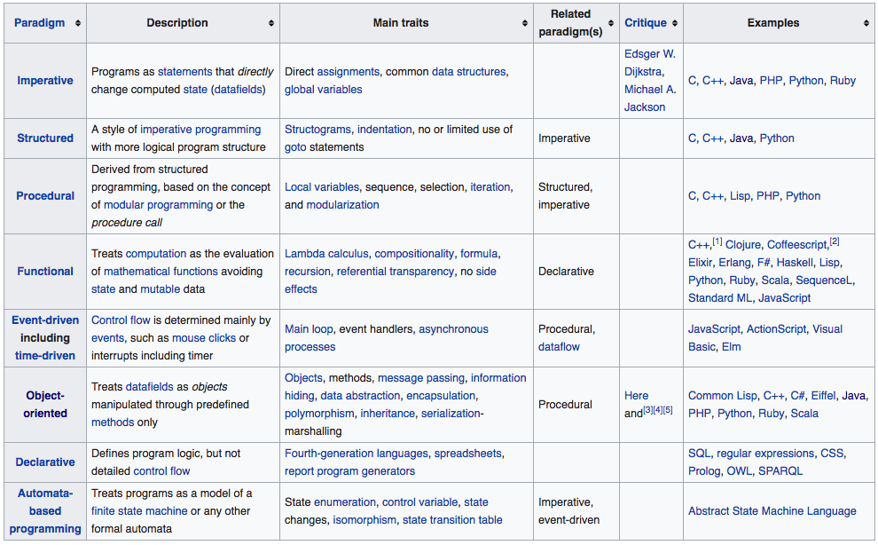
Programming Paradigms

Slide 36
Data Structures
What: In computer science, a data structure is a particular way of organizing data in a computer so that it can be used efficiently.
Usage: Different kinds of data structures are suited to different kinds of applications, and some are highly specialized to specific tasks. For example, relational databases commonly use B-tree indexes for data retrieval, while compiler implementations usually use hash tables to look up identifiers. Data structures provide a means to manage large amounts of data efficiently for uses such as large databases and internet indexing services. Usually, efficient data structures are key to designing efficient algorithms.
Implementation: The implementation of a data structure usually requires writing a set of procedures that create and manipulate instances of that structure. The efficiency of a data structure cannot be analyzed separately from those operations. This observation motivates the theoretical concept of an abstract data type, a data structure that is defined indirectly by the operations that may be performed on it, and the mathematical properties of those operations (including their space and time cost).
Name
Type

Slide 37
Data Structures: Common
Name
Type

Slide 38
Algorithms
What: An algorithm is an effective method that can be expressed within a finite amount of space and time and in a well-defined formal language for calculating a function. Starting from an initial state and initial input (perhaps empty), the instructions describe a computation that, when executed:
Proceeds through a finite number of well-defined successive states,
Eventually producing "output"
And terminating at a final ending state.
The transition from one state to the next is not necessarily deterministic; some algorithms, known as randomized algorithms, incorporate random input.
Implementation: Most algorithms are intended to be implemented as computer programs. However, algorithms are also implemented by other means, such as in a biological neural network (for example, the human brain implementing arithmetic or an insect looking for food), in an electrical circuit, or in a mechanical device.
Name
Type

Slide 39
Algorithms: Insights
Name
Type

Slide 40
Thank You !

